Slide 1
Assessing the Impact of Chronic Diseases on COVID-19 Mortality in the U.S
By Vineet Mehta

Slide 2
The Business Problem
The COVID-19 pandemic not only presented a global health crisis but also highlighted deep-seated disparities in public health outcomes, particularly in the United States.
These disparities are intricately linked to pre-existing chronic health conditions, which significantly elevate the risk of severe illness and death due to COVID-19.

Slide 3
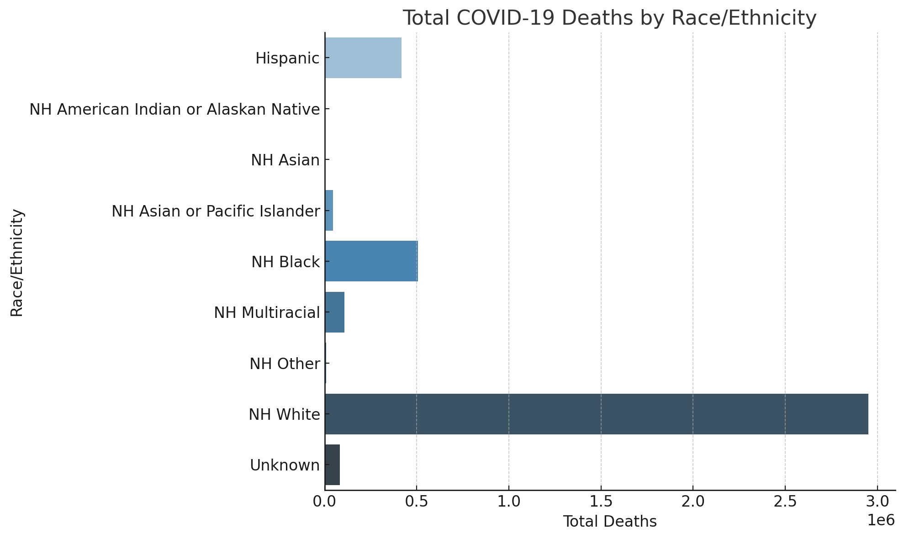
Total COVID-19 Deaths by Race/Ethnicity

Slide 4
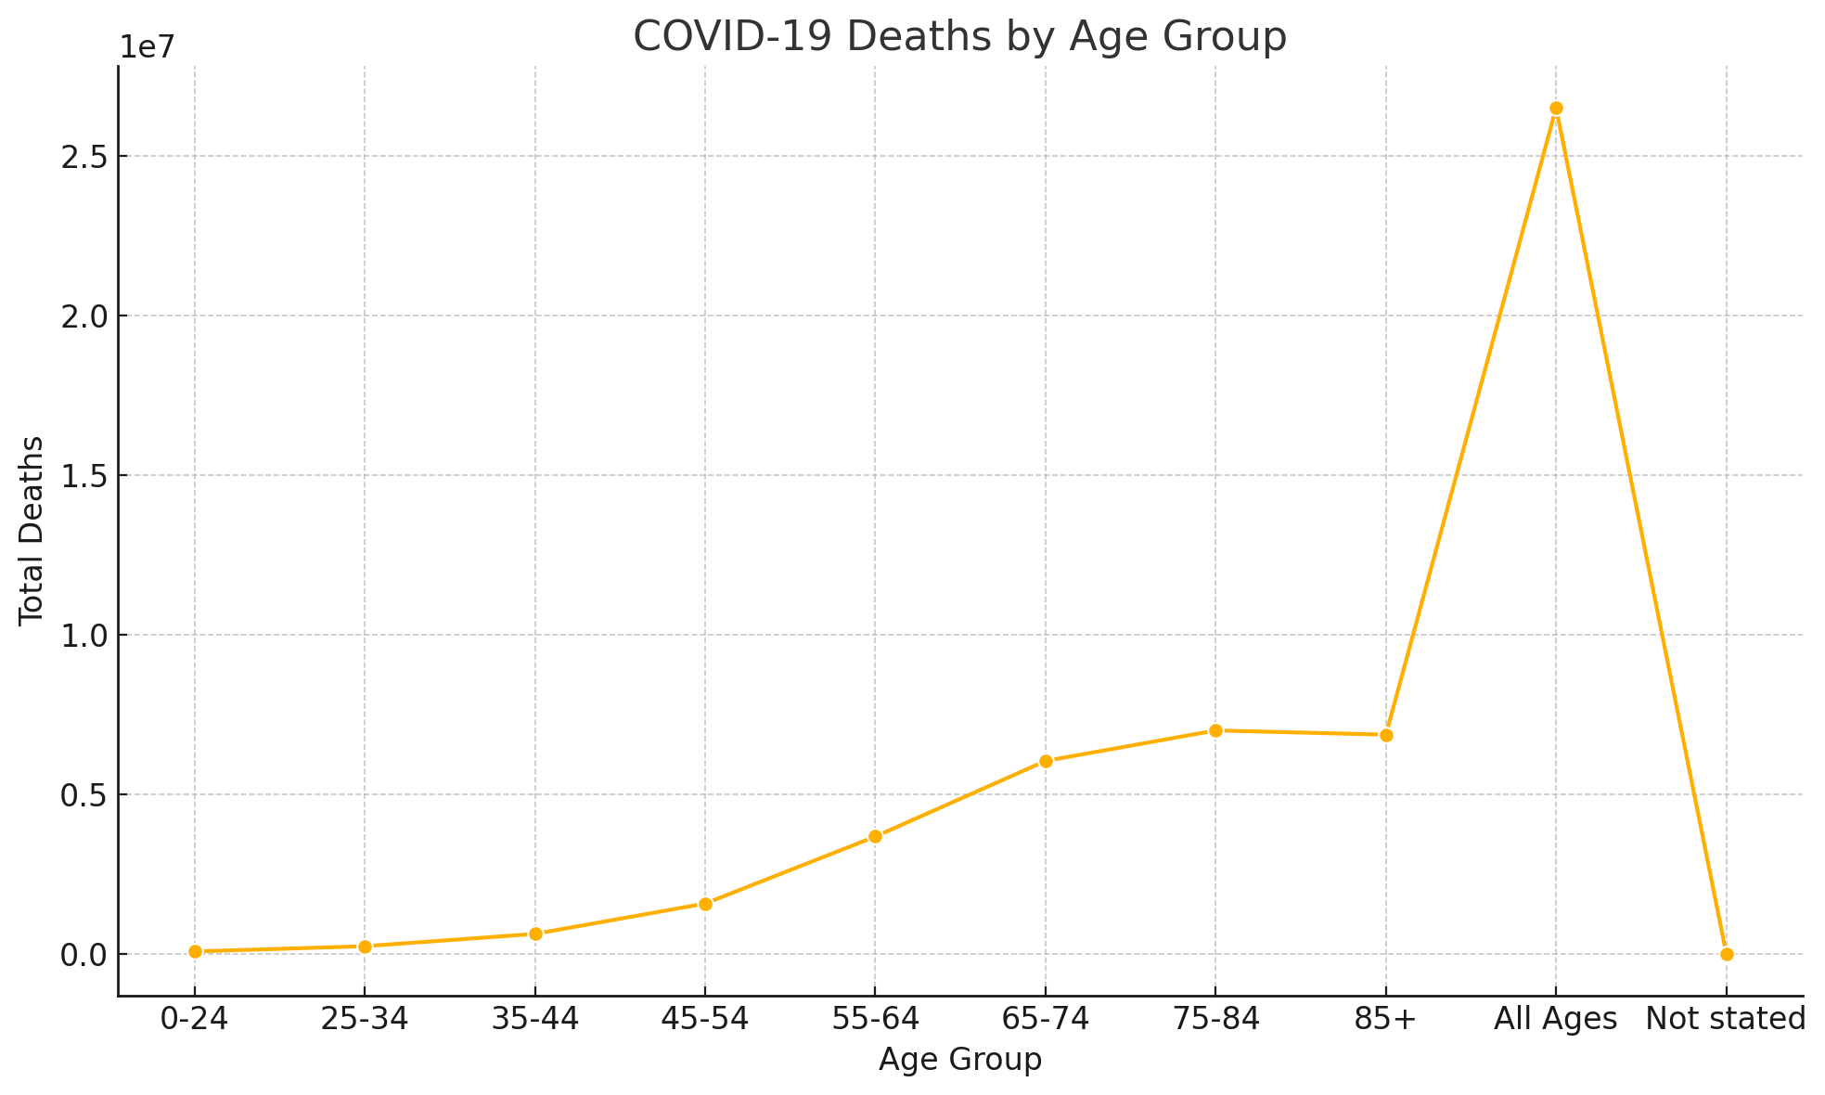
COVID-19 Deaths by Age Group

Slide 5
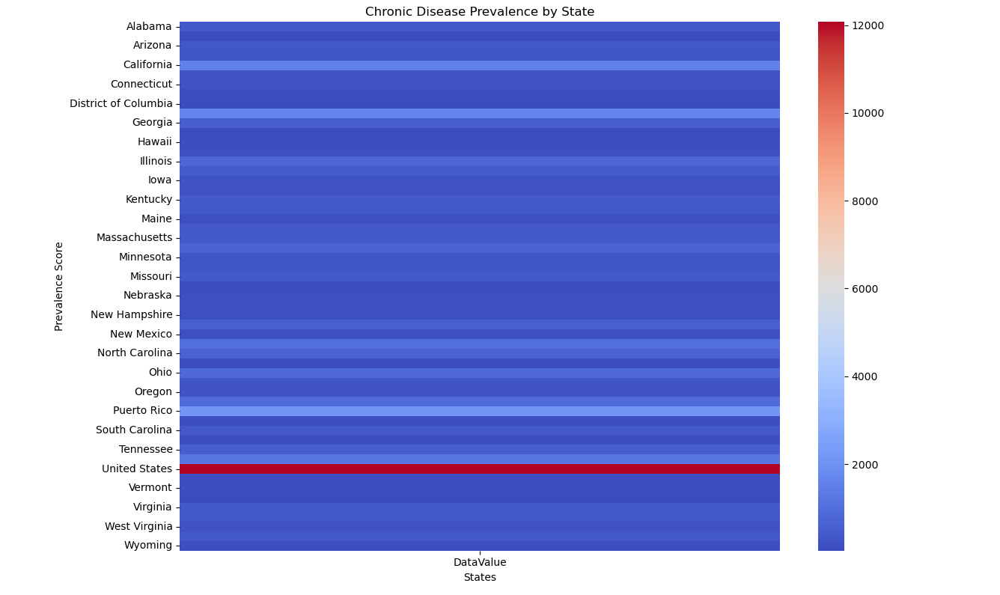

Chronic Disease Prevalence by State

Slide 6
Summary
The COVID-19 pandemic underscored significant health disparities, particularly in the United States. Vulnerable populations, already burdened by chronic health conditions, faced heightened risks of severe illness and mortality. These pre-existing conditions amplified the effects of the pandemic, revealing systemic inequities in healthcare access and outcomes. Addressing these disparities is crucial to improving resilience in public health and ensuring equity in health interventions.

Slide 7

Final Thought
Key Points:
Chronic Conditions as Risk Amplifiers
Disparities in Health Outcomes
Need for Preventive Measures
Equity in Healthcare
Focus on Data-Driven Interventions

Slide 8

Thank You

